Slide 1
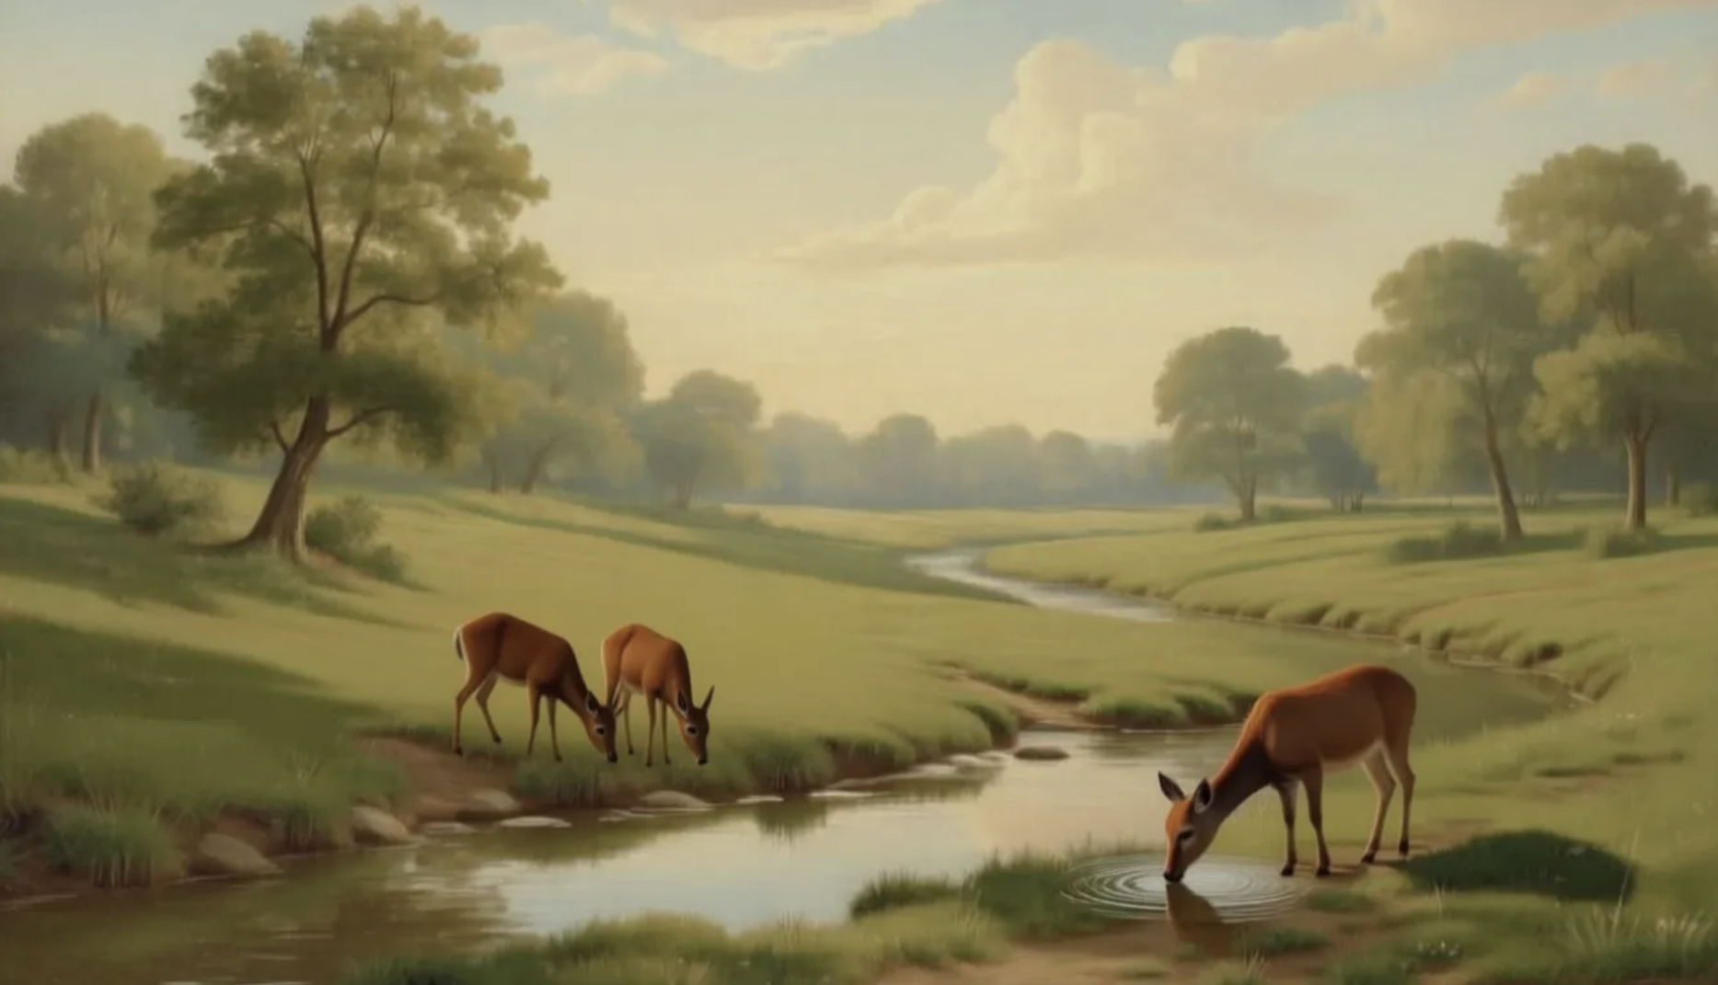
如鹿渴慕溪水
As the deer
Martin Nystrom 词/曲

Slide 2
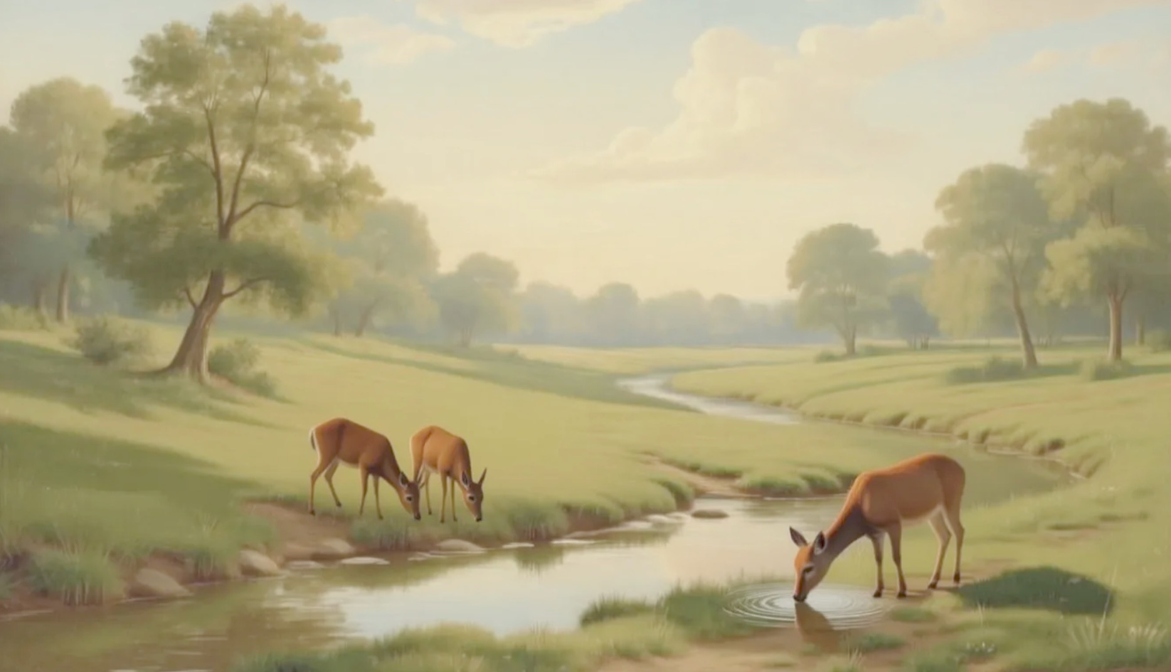
神啊我的心切慕你
如鹿 切慕溪水.
As the deer panteth for the water so my soul longeth after thee
As a deer 1.1/3

Slide 3
惟有你是我心所愛
我渴慕來敬拜你.
You alone are my heart’s desire and I long to worship thee
As a deer 1.2/3

Slide 4
你是我的力量盾牌
我靈單單降服於你
You alone are my strength my shield to You alone may my spirit yield
As a deer 1/2 chr

Slide 5
惟有你是我心所愛
我渴慕來敬拜你.
You alone are my heart’s desire and I long to worship thee
As a deer 2/2 chr

Slide 6
唯有你能满足我心
你比金 银更宝贵
I want You more than gold and silver only You can satisfy
As a deer 2.1/3

Slide 7
惟有你使我心喜乐
你是我全心所爱.
You alone are my real joy giver and apple of my eye
As a deer 2.2/3

Slide 8
你是我的力量盾牌
我靈單單降服於你
You alone are my strength my shield to You alone may my spirit yield
As a deer 1/2 chr

Slide 9
惟有你是我心所愛
我渴慕來敬拜你.
You alone are my heart’s desire and I long to worship thee
As a deer 2/2 chr

Slide 10
你愿成为我的朋友
即使你 是尊贵君
You are my friend and You are my brother even though you are a King
As a deer 3.1/3

Slide 11
我愛你胜过世上一切
无人能与你相比
I love You more than any other so much more than anything
As a deer 3.2/3

Slide 12
你是我的力量盾牌
我靈單單降服於你
You alone are my strength my shield to You alone may my spirit yield
As a deer 1/2 chr

Slide 13
惟有你是我心所愛
我渴慕來敬拜你.
You alone are my heart’s desire and I long to worship thee
As a deer 2/2 chr

Slide 14
惟有你是我心所愛
我渴慕來敬拜你.
You alone are my heart’s desire and I long to worship thee
As a deer 2/2 chr

